Slide 1

Mozilla Firefox
An Overview by
Nikit “Nefari0us” Malkan
26 Febuary 2015

Slide 2


History
Mozilla started in 1998.
First release of Firefox was called Phoenix.
Renamed to Firebird.
Non-profit organization.
Helped revolutionize browsers.
Current release is Firefox 36.

Slide 3


Desktop Versions
Release/Beta
Developer Edition
Nightly

Slide 4

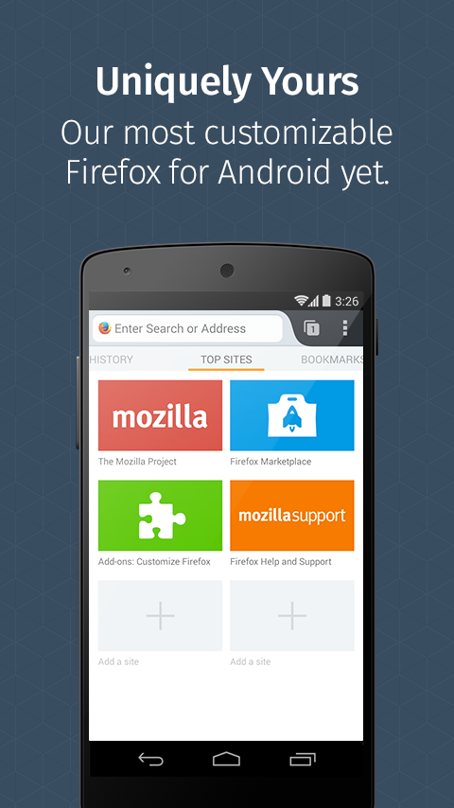
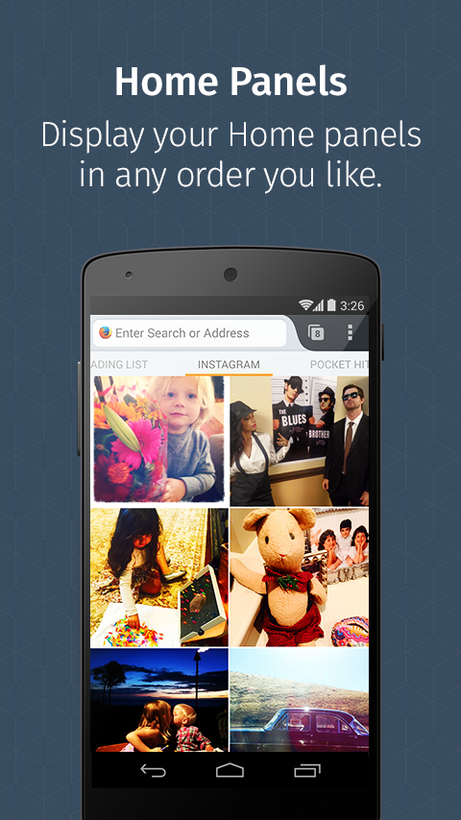
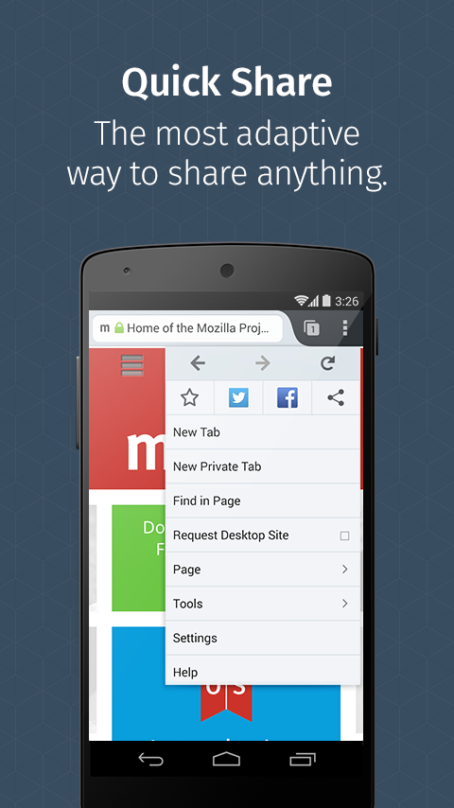
Android Phone Interface

Slide 5
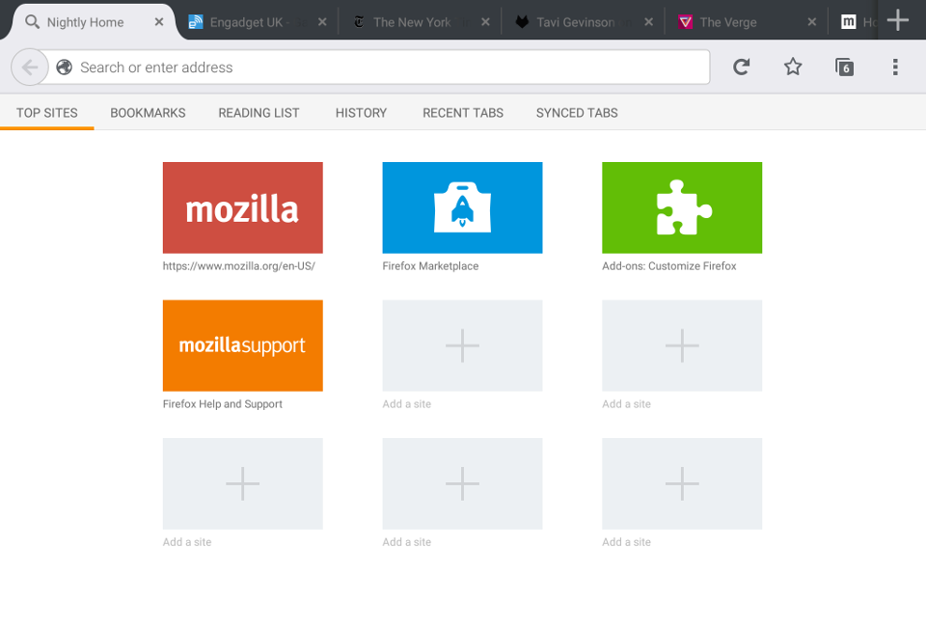
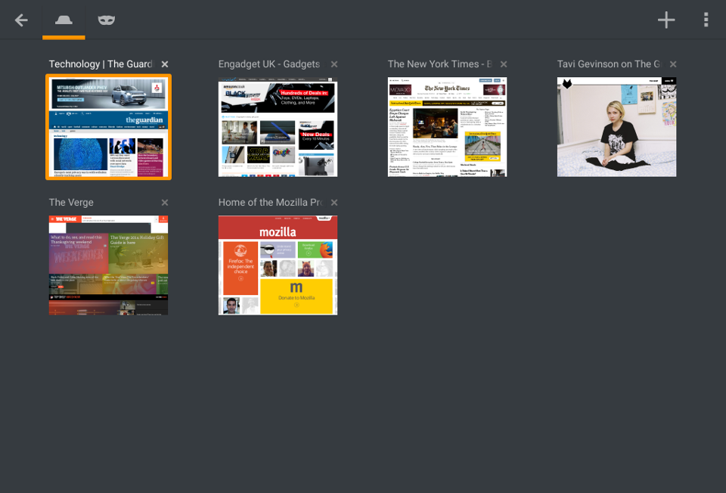
Android Tablet Interface

Slide 6
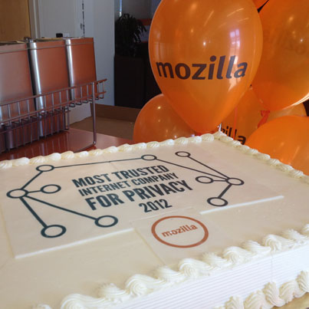
Why Should You Use Firefox?
Different by Design
Privacy & Security
Mozilla is Most Trusted Internet Company in Privacy
Named on 2015by Ponemon Institute LLC
Moz
illa Manifesto
Do Not Track Initiative
Mozilla Public License
Hybrid of modified BSD and GPL
Almost Infinite Customizability

Slide 7

Some Awesome Features
Awesomebar
Keyword Searching
Paranorma
Tab Search
Sidebar
History Search
Bookmarks
Tagging
Load in Sidebar
Developer Console
Responsive Web Design
3D Mode
Firefox Hello
about:config

Slide 8
AwesomeBar Searching
^ to search for matches in your browsing history.
* to search for matches in your bookmarks.
+ to search for matches in pages you've tagged.
% to search for matches in your currently open tabs.
~ to search for matches in pages you've typed.
# to search for matches in page titles.
@ to search for matches in web addresses (URLs).

Slide 9

Add-ons & Themes!
Fully skinnable.
Add-ons for just about everything.
Some of my favourites…

Slide 10
Thanks for Listening
Sources: Wikipedia.org, Mozilla.org

